Slide 1
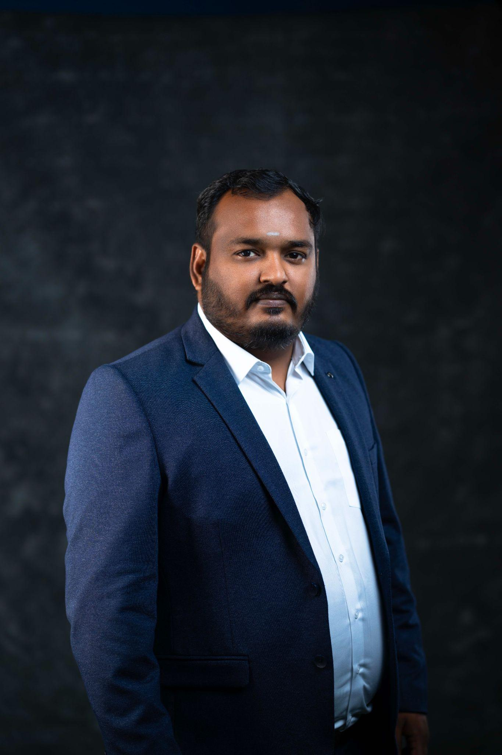
New Member Induction
Name : R. Balamurugan
Business Name : BM Wall
Category : Toughened Glass Works and Facades
Mobile : 9884178100
Sponsor : Mr. Velmurugan

Slide 2
New Member Introduction
Balamurugan is a Civil Engineer by profession - He was born in Dubai and brought up in Mayiladuthurai.
He holds a professional degree in civil engineering from St Peter's Engineering college, Chennai.
His company – BM WALL have designed and planned some of the most innovative residential and commercial buildings across Tamil Nadu.
His passion towards this field is not just a career choice; it's a way of life. He loves travelling and exploring new culture and foods . He regularly attends expos and industry meetings, seeking opportunities to connect with like-minded individuals who share his enthusiasm for construction and architectural excellence.

